Slide 1
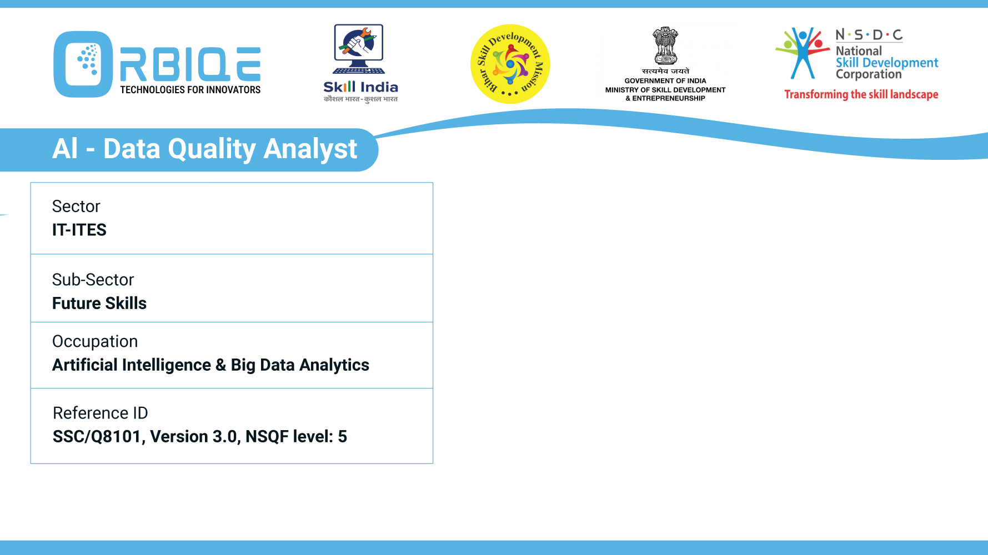


Name- Krishna Kant Dubey

Slide 2

Pre-processing Data

Slide 3
Unprocessed vs. Processed Data: Key Differences
Feature | Un Processed Data | Processed Data
Definition | Raw data collected from sources | Data that has been cleaned, transformed, or enriched
Format | Often inconsistent, messy, or unstructured | Structured, standardized, and analysis-ready
Examples | Logs, sensor outputs, API dumps, CSV uploads | Aggregated tables, normalized DBs, feature sets

Slide 4
Agenda
Differentiate the unprocessed and processed data
Explain the impact of unprocessed data on subsequent analytical operations
Describe the various anomalies that may be found in unprocessed data

Slide 5
Unprocessed vs. Processed Data: Key Differences
Feature | Un Processed Data | Processed Data
Usability | Not ready for analysis | Ready for querying, modeling, or visualization
Storage Location | Data lake, raw S3 bucket, staging DB | Data warehouse, analytics DB, dashboards
Common Issues | Missing values, duplicates, noise | Minimal errors, validated schema
Metadata Availability | Sparse or absent | Rich metadata with lineage and descriptions
Usability | Metadata Availability | Sparse or absent
 | Security & Compliance | May contain sensitive or unfiltered info

Slide 6

Unprocessed Data

Slide 7

Processed Data

Slide 8
Automate with ETL Tools
Airflow or Dagster for orchestration
Pandas or PySpark for transformation
Great Expectations for validation
AWS Glue or dbt for metadata and lineage tracking

Slide 9
Impact of Unprocessed Data on Analytical Operations
Reduced Data Quality
Issue: Raw data often contains errors, missing values, duplicates, and inconsistencies.
Impact: Leads to unreliable insights, skewed results, and poor decision-making.
Example: A missing timestamp in a time series can distort trend analysis or forecasting.

Slide 10
Impact of Unprocessed Data on Analytical Operations
Poor Model Performance
Issue: Machine learning models rely on clean, well-structured input.
Impact: Noisy or irrelevant features reduce accuracy and increase overfitting.
Example: Unnormalized numerical data can bias regression coefficients or distance-based algorithms.

Slide 11
Impact of Unprocessed Data on Analytical Operations
Increased Complexity and Processing Time
Issue: Unprocessed data often includes redundant or irrelevant fields.
Impact: Slows down computation, increases memory usage, and complicates workflows.
Example: A dataset with 100+ columns may require dimensionality reduction before modeling.

Slide 12
Impact of Unprocessed Data on Analytical Operations
Misleading Insights
Issue: Inconsistent formats or unstandardized categories can lead to false correlations.
Impact: Analysts may draw incorrect conclusions or miss key patterns.
Example: “North” vs. “north” vs. “N” in a region column can fragment group analysis

Slide 13
Impact of Unprocessed Data on Analytical Operations
Compliance and Security Risks
Issue: Raw data may contain sensitive or personally identifiable information (PII).
Impact: Violates data protection regulations like GDPR or HIPAA.
Example: Unmasked email addresses or birthdates in logs can trigger legal penalties.

Slide 14
Impact of Unprocessed Data on Analytical Operations
Limited Automation and Scalability
Issue: Unstructured or inconsistent data resists automation.
Impact: Manual intervention is needed, reducing scalability and increasing operational costs.
Example: ETL pipelines may fail if schema mismatches or null values aren’t handled.

Slide 15
Thank You

